Slide 1
Certifications and Security +
Cybersecurity 101 Day 3

Slide 2

Class Objectives
By the end of today’s class, you will be able to:
Explain the landscape of certifications available to security professionals.
Articulate what the Security + exam is and what InfoSec fields would benefit from obtaining the certification.
Answer sample practice questions from the Security + exam.

Slide 3

quick
Let’s do a review!
‹#›
Notes:
Image source: AdobeStock_121721042

Slide 4

Quick Review
Last class, we introduced a framework that captures the fundamental goal of information security.
What was the framework?
Notes:
Image Source: shutterstock_1285831843

Slide 5

Quick Review
The framework that captures the fundamental goal of information security:
The CIA Triad
‹#›

Slide 6
Quick Review
What are the three elements of the CIA Triad?
Notes:
Image Source: shutterstock_1285831843

Slide 7

Quick Review
The three elements of the CIA Triad are:
Availability Integrity Confidentiality
1
Availability
2
Integrity
INFORMATION
SECURITY
3
Confidentiality
‹#›

Slide 8
Quick Review
Define each of the three elements in the context of information security:
Confidentiality
Integrity
Availability
Notes:
Image Source: shutterstock_1285831843

Slide 9
Quick Review
Confidentiality: Ensuring sensitive information is protected from reaches of unauthorized persons.
Integrity: Protection of information from being modified or tampered by unauthorized persons.
Availability: Assuring that all operating systems, equipment, and data are functioning correctly and accessible by those who need it.
‹#›

Slide 10
Quick Review
Provide an example of how each of the three elements can be adversely affected:
Confidentiality
Integrity
Availability
Notes:
Image Source: shutterstock_1285831843

Slide 11
Quick Review
Confidentiality: Banking breach releases credit card info into the public.
Integrity: Student modifies official grades for himself and his friends.
Availability: Hackers disable a website through a denial of service attack.
‹#›

Slide 12
Research Presentations

Slide 13
1 Hour 30 Minutes
Activity: Research Presentations
Last class, we introduced a number of threats for you to explore. In this activity, you will present your group research.
Make sure to send your presentations to the instructor via Slack.
‹#›

Slide 14
Homework Review: Research Discussions
What is this threat? (or What was it?)
What damage has it done?
What steps can or have been taken to mitigate?
Emotet | Zealot Campaign | Digmine | Triton | BadRabbit
Disakil | Finfisher | Thrip | Orangeworm | Ploutus ATM Malware
Gh0st RAT | Trickbot | Necurs | BlankSlate | CVE-20170199
Vulnerability, Exploits, and Threat Actors
‹#›

Slide 15

Notes:
Image source: AdobeStock_56885471

Slide 16
Security Certifications

Slide 17
Security Certifications
As the demand for cybersecurity careers grows, employers frequently look to certification as a measure of employee qualifications and training when hiring candidates.
CompTIA certifies Security +, PenTest.
EC Council certifies CEH and ECIH.
ISC² certifies CISSP, SSCP.
Offensive Security certifies OSCP and OSWP.
GIAC certifies GPEN and GCIH.
Today, we’ll take a closer look at CompTIA’s Security + certification and exam.

Slide 18
3-5 minutes
Activity: Certification Landscape
Let’s take a quick look at this list of over 100 Professional Security Certifications!
https://en.wikipedia.org/wiki/List_of_computer_security_certifications

Slide 19

Of the 100+ certifications, today we’ll focus on one of the most in-demand:
Security +
‹#›
Notes:
Image source: Studio Bolland

Slide 20
What is a Security +?
According to CompTIA, Security +:
Is the first security certification that IT professionals should earn.
Establishes core knowledge required for any cybersecurity roles.
Provides a springboard to intermediate-level cyber jobs.
Incorporates hands-on troubleshooting to ensure practical security problem-solving.
CompTIA (Computing Technology Industry Association) is an non-profit trade organization that certifies qualified applicants in various information technology skills.
They provide testing and certification for the Security + and other Cyber and IT fields like Network +, CASP +, CompTIA PenTest+.

Slide 21
Introduction to Security + Certification
What are some jobs that may require the Security + certification?
Security
Consultant
Security
Architect
Information Security
Analyst
Security
Engineer
Security
Specialist
Security /
Systems
Administrator

Slide 22

As of Dec 10, 2019, the average annual pay for an Information Security Analyst in the United States is $98,735.
Stat Reference: https://www.ziprecruiter.com/Salaries/Information-Security-Analyst-Salary
Notes:
Image source: shutterstock_294234533

Slide 23

When Should You Take The Exam?
Security + is considered an entry-level exam. The skills we’ll learn in this course will offer strong foundations for many topics covered on the exam.
However, the Sec+ exam is broad and will require additional knowledge in areas that aren’t covered in this program.
The CompTIA CertMaster tool will provide the material needed to cover these gaps and master the exam.
Notes:
Image source: shutterstock_1560319826

Slide 24


Why Don’t We Cover Everything on the Sec+ exam?
This course focuses on providing relevant hands-on experience of the most prominent and useful concepts, tools, and technologies used in security and networking. It is not a test prep course.
Some topics on the Security+ exam are not covered in this course because they are highly specific, and relevant only to certain subfields of cybersecurity.
Therefore, while this course and exam share many overlapping coverage of topics, more niche topics that the exam covers will require additional study.
For example, the TACACS+ protocol appears on the Security+ exam, but only engineers who work specifically with Cisco devices will ever use it.
Notes:
Image source: Jeevanantham_Jiva

Slide 25
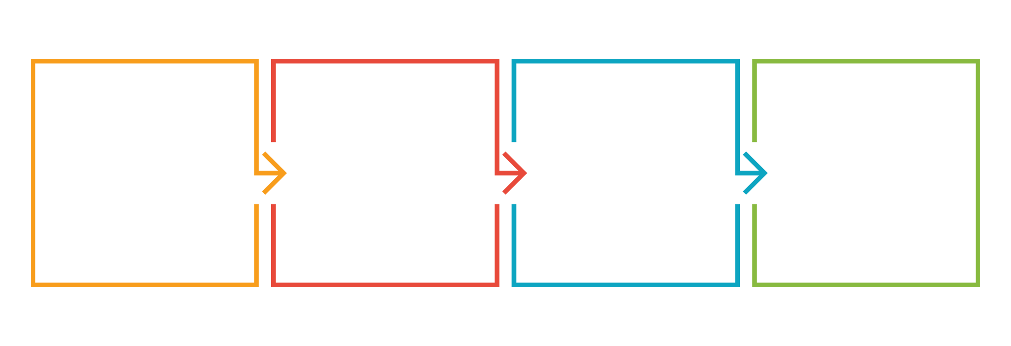
Security + Specs
The Security + Certification is obtained through passing the CompTIA administered Security + exam.
There are 90 multiple-choice and performance based questions.
The exam lasts 90 minutes.
The cost of the exam is $339.
The exam is vendor-neutral.
Notes:
Image source: shutterstock_1276756537

Slide 26
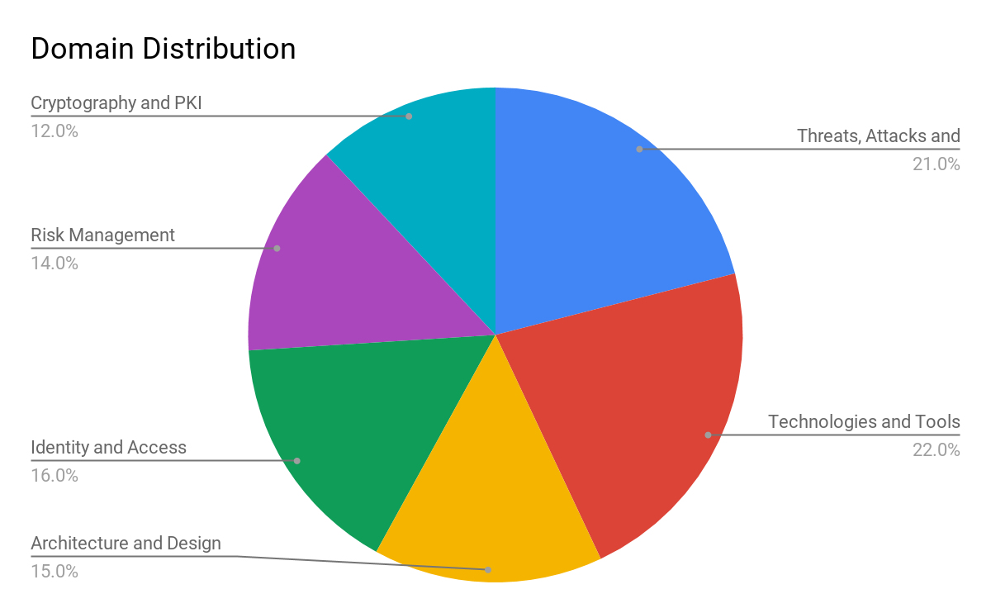
Security + Exam Topics Breakdown
Threats, Attacks, and Vulnerabilities
Technologies and Tools
Architecture and Design
Identity and Access Management
Risk Management
Cryptography and PKI

Slide 27
Question Formatting

Slide 28
There are two types of questions on the Security + exam: Multiple Choice and Performance Based.

Slide 29

Example Question: Multiple Choice
Which of the following describes a logic bomb?
A program that performs a malicious activity at a specific time or after triggering an event.
A type of malicious code similar to a virus whose primary purpose is to duplicate itself, and spread while not necessarily internally damaging or destroying resources.
A program that appears to be a legitimate application, utility, game or screen saver that performs malicious activities surreptitiously.
A program that has no useful purpose, but attempts to spread itself to other systems and often damages resources on the system where it is found.
Notes:
Image source: shutterstock_1028887237

Slide 30
Example Question: Multiple Choice
Which of the following describes a logic bomb?
A program that performs a malicious activity at a specific time or after triggering an event.
A type of malicious code similar to a virus whose primary purpose is to duplicate itself, and spread while not necessarily internally damaging or destroying resources.
A program that appears to be a legitimate application, utility, game or screen saver that performs malicious activities surreptitiously.
A program that has no useful purpose, but attempts to spread itself to other systems and often damages resources on the system where it is found.
Notes:
Image source: shutterstock_1028887237

Slide 31

Example Question: Performance Based
Scenario: You are responsible for security at a small organization and have been tasked with implementing a security policy. Place the actions of organizing a security policy in their appropriate order. Note that there are five options, but you need to choose four.
Step 1 ______ ---> Step 2 ______ ---> Step 3 ______ ---> Step 4 ______
Possible choices:
Obtain support and commitment from management
Analyze risks to security
Secure budgeting
Review, test, and update procedures
Implement appropriate controls
Notes:
Image source: shutterstock_1169662366

Slide 32
Example Question: Performance Based
Scenario: You are responsible for security at a small organization and have been tasked with implementing a security policy. Place the actions of organizing a security policy in their appropriate order. Note that there are five options, but you need to choose four.
Step 1 ______ ---> Step 2 ______ ---> Step 3 ______ ---> Step 4 ______
Step 1: Obtain support and commitment from management
Step 2: Analyze risks to security
Step 3: Implement appropriate controls
Step 4: Review, test, and update procedures
Notes:
Image source: shutterstock_1169662366

Slide 33
Other Sample PBQs
You are in charge of creating an Incident Response process for your company. Match the procedures (not mentioned in this example) with the correct phases of the IR plan.
The phases are:
Preparation, Identification/Detection, Analysis, Containment, Eradication, Recovery
You are in charge of deploying Public Key Infrastructure (PKI) into your environment, and for this you need to have a good foundation in cryptographic technology. Drag the appropriate terminology with the function its used for.
Terms are:
public key, private key, hash, digital signature.
You need to perform a Business Impact Analysis for a set of critical servers as part of a risk management push by your company. Organize the steps of a Business Impact Analysis (BIA) in their proper order.
The steps are: Identify Threats, Remediate Risk, Assign risk to each function or asset, Identify critical functions or processes, Identify assets and resources

Slide 34
CertMaster Practice Tool

Slide 35
CompTIA CertMaster Practice Tool
The practice Tool takes a “question-first” approach to test prep.
Practice questions are organized according to the six different domains covered in the exam.
These questions are then divided into subcategories that comprise of different topics and tools within the domain.
CertMaster is an adaptive knowledge assessment tool.
Meaning: based on your results of practice questions, CertMaster will determine which categories you mastered and which categories need more practice.

Slide 36
Domain 1:
Threats, Attacks and Vulnerabilities

Slide 37

Domain 1: Threats, Attacks and Vulnerabilities
Subtopics and Examples Included:
Malware Types: Ransomware, Trojans, Adware
Social Engineering: Phishing, Vishing
Application Attacks: DDOS, Cross Site Scripting, DNS Poisoning
Wireless Attacks: Bluejacking, Evil Twin
Cryptographic Attacks: Birthday Attack, Rainbow Tables
Threat Actors: Script Kiddies, Hacktivists
Vulnerability Scanning: ID-ing Misconfigurations, lack of security controls
Vulnerability Types: Improper Input Handling, Improper Error Handling
Notes:
Image source: shutterstock_566786470

Slide 38
Domain 1: Sample Question #1
A system being investigated is found to have had several of its core operating system files modified, but no traces of malware are found. What type of attack is this and how was it able to avoid detection?
The system is infected with a Trojan. It is able to avoid detection by operating in kernel mode and blocking attempts to detect it.
The system is infected with a rootkit. It is able to avoid detection by operating in kernel mode and blocking attempts to detect it.
The system has been compromised with an exploit framework. The attack is not detectable because it has migrated to another process.
The system has been compromised with an APT attack. It is not detectable as malware because the attacker is controlling the system directly.

Slide 39
Domain 1: Sample Question #1
A system being investigated is found to have had several of its core operating system files modified, but no traces of malware are found. What type of attack is this and how was it able to avoid detection?
The system is infected with a Trojan. It is able to avoid detection by operating in kernel mode and blocking attempts to detect it.
The system is infected with a rootkit. It is able to avoid detection by operating in kernel mode and blocking attempts to detect it.
The system has been compromised with an exploit framework. The attack is not detectable because it has migrated to another process.
The system has been compromised with an APT attack. It is not detectable as malware because the attacker is controlling the system directly.

Slide 40
Domain 1: Sample Question #2
Of a vulnerability, threat, exploit, and risk, which would be assessed by likelihood and impact?
Vulnerability
Risk
Threat
Exploit

Slide 41
Domain 1: Sample Question #2
Of a vulnerability, threat, exploit, and risk, which would be assessed by likelihood and impact?
Vulnerability
Risk
Threat
Exploit

Slide 42
Domain 1: Sample Question #3
In which stage of the “kill chain” does a threat actor first gain access to a resource on the target network?
Exploit
Reconnaissance
Installation
Command and Control

Slide 43
Domain 1: Sample Question #3
In which stage of the “kill chain” does a threat actor first gain access to a resource on the target network?
Exploit
Reconnaissance
Installation
Command and Control

Slide 44

Next, we’ll take a look at some of the Domain 1 sub-topics and take some practice questions.
Don’t feel overwhelmed by the amount of information we’re about to cover. You’re not expected to learn all of this material today. Rather, we want to give you a taste of the content that is covered in the exam.
Notes:
14. Instructor Do: lesson plan pgs. 40-41

Slide 45
Domain 1: Sub-modules in CertMaster
Within this domain are five sub-modules:
1.1
1.3
1.5
Given a scenario, analyze indicators of compromise and determine the type of malware.
Explain threat actor types and attributes.
Explain vulnerability scanning concepts.
1.2
1.4
Compare and contrast types of attacks.
Explain penetration testing concepts.
Let’s review threat actor types, to prepare for questions in sub-module 1.3:

Slide 46
Threat Actors: External
There are various external threat actors:
The Lone Hacker (Black Hat / Script kiddies)
Organized Cyber Crimes
Nation State / Advanced Persistent Threat (APT)
Hacktivists
Competitor
Notes:
The Lone Hacker: Experts in computer security are popularly referred to as hackers. A hacker who breaks into a computer system with the intent of causing damage or theft is referred to as a Black Hat hacker. A White Hat hacker acts in an ethical manner, as a security professional who do not have malicious intents.
A script kiddie is someone that uses hacker tools but may not necessarily have full knowledge of how they work. Oftentimes, they also may not be able to create new attacks.
While "lone hackers" are still threats, most threat actors are now likely to work as part of some sort of group.
Organized Cyber crime: Organized crime will seek any opportunity for criminal profit, but typical activities are financial fraud (both against individuals and companies) and blackmail. Because they can operate across the internet in a totally different state or country from their victims, there are many complexities to prosecution.
Nation State/Advanced Persistent Threat (APT): Many nation states have developed cybersecurity expertise and will use cyber weapons to achieve both military and commercial goals.
Advanced Persistent Threat (APT) refers to the behavior of these cyber adversaries. Instead of simply infecting a system with a virus or a rootkit, these adversaries are more interested in a continuous ability to compromise network security using different tools and techniques.
Typically nation state actors are primarily interested in espionage and strategic advantage, but commercial gain can also be a motivation.
Even though they are state-sponsored, nation state actors may often pose as independent groups or hacktivists.
Hacktivists: Hacktivist groups, such as Anonymous, WikiLeaks, or LulzSec, are interested in a political agenda. For example, they may try to obtain and leak confidential information to the public domain, perform Denial of Service Attacks or deface websites against targeted groups.
Competitor: Competitor-driven espionage is usually done by nation state groups, but it is also possible that a business might engage in cyber espionage against its competitors.

Slide 47

Threat Actors: Inside Threats
Inside Threats are affiliated with the organization: staff, partners, stakeholders, etc.
Motivations include: sabotage, revenge, financial or business gains.
Inside actors are more likely to bypass technical controls, meaning strong operational and management controls are needed to mitigate threats, such as:
– Comprehensive on and off-boarding
– Mandatory vacations
– User awareness / training
–Principle of least privilege
We’ll dive into this topic during our Governance, Risk and Compliance week.
Notes:
Image source: shutterstock_575243947

Slide 48
Activity: Threat Actor Type Questions
In this activity, you will work through Module 1.3 of the CertMaster Practice.
(Question sheets will be sent out by instructor.)
10 minutes

Slide 50
Question 1:
Which of the following threat actors or threat actor groups is most likely to have the best funding to hire and sustain a group of hackers?
Nation states
Organized crime
Script kiddies
Hacktivist groups

Slide 51
Question 1:
Which of the following threat actors or threat actor groups is most likely to have the best funding to hire and sustain a group of hackers?
Nation states
Organized crime
Script kiddies
Hacktivist groups
Extended Explanation:
Nation states have tax revenues, backing from large companies, and/or wealthy benefactors who fund malicious activities.
Well-funded, organized crime does not have the resources of an entire nation behind them.
Script kiddies do not have any funding because they are typically young and inexperienced and do not qualify for any backing.
Hacktivist groups might have minor funding from opposing viewpoint factions but the funding is not significant nor comparable to nation states.

Slide 52
Question 2:
Which feature of insider threat actors makes them especially dangerous to an organization?
They have unrestricted access to sensitive data and information.
They oppose the organization’s political or ideological goals.
They launch advanced persistent attacks (APTs) against their own organization.
They use canned threat programs to launch their attacks.

Slide 53
Question 2:
Which feature of insider threat actors makes them especially dangerous to an organization?
They have unrestricted access to sensitive data and information.
They oppose the organization’s political or ideological goals.
They launch advanced persistent attacks (APTs) against their own organization.
They use canned threat programs to launch their attacks.
Extended Explanation
Insider actors are dangerous because they have unrestricted access to sensitive data and information. That data can then be easily stolen or leaked by someone with appropriate access.
The insider would prefer to stay in stealth mode and an APT will give away their intent.
A hacktivist would oppose the organization’s political or ideological goals. An insider would never reveal this oppositional nature.
Script kiddies use prebuilt or canned programs for attacks. Such attacks would likely give away the insider’s position and intent.

Slide 54
Question 3:
Of the several types of threat actors, which one is a novice with little experience as a hacker?
Insider
Script Kiddie
Competitor
Hacktivist groups

Slide 55
Question 3:
Of the several types of threat actors, which one is a novice with little experience as a hacker?
Insider
Script Kiddie
Competitor
Hacktivist groups
Extended Explanation
Script kiddies use prebuilt or canned programs for attacks. Such attacks would likely give away the insider’s position and intent.
Insider actors are dangerous because they have unrestricted access to sensitive data and information. That data can then be easily stolen or leaked by someone with appropriate access.
The insider would prefer to stay in stealth mode and an APT will give away their intent.
A hacktivist would oppose the organization’s political or ideological goals. An insider would never reveal this oppositional nature.

Slide 56
Question 4:
Which threat actor is MOST likely to be highly skilled in launching attacks involving advanced persistent threats (APTs) against targets?
Script kiddie
Nation state
Insider
Organized crime

Slide 57
Question 4:
Which threat actor is MOST likely to be highly skilled in launching attacks involving advanced persistent threats (APTs) against targets?
Script kiddie
Nation state
Insider
Organized crime
Extended Explanation
A nation state has the most sophisticated and highly skilled hackers available for launching APTs.
A script kiddies is not highly skilled nor capable of launching APTs against targets.
An insider can be highly skilled but does not use APTs because it would give away their positions and intent.
Organized crime rings are highly skilled but they do not launch APTs against a target.

Slide 58
Question 5:
A group known as “Takedown” hacked into your political action committee website and defaced it. Which type of threat actor is most likely responsible for the attack?
Hacktivist
Script kiddie
Competitor
Insider

Slide 59
Question 5:
A group known as “Takedown” hacked into your political action committee website and defaced it. Which type of threat actor is most likely responsible for the attack?
Hacktivist
Script kiddie
Competitor
Insider
Extended Explanation
"Takedown” is a hacktivist group. Its motivations seem political and it is interested in defacing websites of those who have opposing viewpoints from their own.
Script kiddies typically do not deface websites but only use scripts and applications that help them break into systems or applications with known vulnerabilities.
Although a malicious insider might have the ability to deface the site, it’s unlikely that this would be their course of action because insiders usually exfiltrate data rather than deface sites.
It’s unlikely that a competitor would deface the site but rather would look for a list of donors or other sensitive information.

Slide 60
Question 6:
What aspect of cybercrime often motivates script kiddies to hack into systems or into a company?
Confidential company information
Financial motivation and ability to sell information
Collaboration with government and other agencies
Bragging rights, publicity, or other form of notoriety

Slide 61
Question 6:
What aspect of cybercrime often motivates script kiddies to hack into systems or into a company?
Confidential company information
Financial motivation and ability to sell information
Collaboration with government and other agencies
Bragging rights, publicity, or other form of notoriety
Extended Explanation
Script kiddies generally only want to be able to tell their friends that they have hacked some company or hear their names on the news.
Script kiddies are not generally profit seekers because they do not have the resources for acquisition or the sale of these items.
Script kiddies are not involved with government entities or agencies and therefore do not seek this type of information or activity.
Private or secret information motivates insiders to become threats. Script kiddies do not gain profits by having access to private or secret information.

Slide 62
Question 7:
Which of the following motivates a hacktivist to perpetrate a website defacing or an informational breach?
Financial gain
Reputational damage to the target
Military tactics and political upheaval
Bragging right or other form of notoriety

Slide 63
Question 7:
Which of the following motivates a hacktivist to perpetrate a website defacing or an informational breach?
Financial gain
Reputational damage to the target
Military tactics and political upheaval
Bragging right or other form of notoriety
Extended Explanation
Hacktivists are interested in damaging or exposing their ideological opposites but not generally for monetary gain or other accolades.
Hacktivists are primarily concerned with damaging the reputations of their targets.
Hacktivists have no interest in military tactics or political upheaval. Their interest is purely ideological.
A boost in recognition is only important to script kiddies who want to show off to friends or rival script kiddie groups.

Slide 64
Viruses and Worms

Slide 65

The Security + Exam covers common types of malware and malware attacks.
We’ll begin coverage by looking at viruses and worms.

Slide 66

Viruses
A virus is a program that copies itself on to other computer systems.
When the user runs the infected application, the virus also runs and copies itself onto other applications on the system as well.
Notes:
Image source: shutterstock_596106722

Slide 67
Viruses
Viruses can damage the infected hosts in the following ways:
Denial of Service Attacks (DoS):
Shutting down the host by using up all of its resources or destroying essential files.
Slowing down the host by using up a computer’s resources, such as CPU and RAM.
Ransomware:
“Scrambling” data on the host, so that users can’t read it, and demanding money to “unscramble” it.

Slide 68

If a virus is just a program containing malicious content, can Apple and Linux computers get viruses?
Notes:
Image Source: shutterstock_1285831843

Slide 69



Viruses on Different Operating Systems
Since a virus is just a program, it can infect any OS: Apple, Linux, Windows, etc.
Windows machines are the most widely used operating systems worldwide, so they are more prone to viruses.
Virus writers tend to target the most prominent machines, to boost the spread of their viruses.
Windows are additionally more vulnerable, because their users often operate machines with administrator privileges.
Therefore, programs will download without the user asking the user.
Mac and Linux users are low-privileged and non-administrator by default.

Slide 70
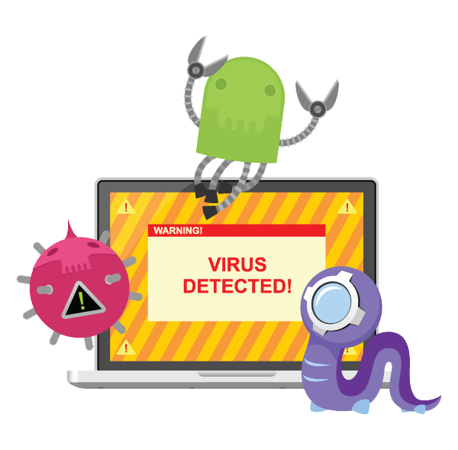
Virus
Types
Boot sector viruses attack the operating system, specifically the disk boot sector information, the partition table, and sometimes the file system.
Program viruses are code that insert themselves into executable programs. The virus becomes active once the program runs. These executable objects can be embedded or attached within other file types such as Word docs and PDFs.
Script viruses are written in a scripting language, such as JavaScript or PostScript.
Script viruses are dangerous because they can be embedded in web pages or PDF files, making them harder to detect.
When a user opens the web page or PDF file, the software that loads the page or PDF will read and run the virus code.
Since the virus was contained in a “normal” web page or PDF document, users typically won’t realize that they’ve been infected.
Notes:
Image source: shutterstock_131138963

Slide 71
Virus
Types
Macro viruses are written in the same macro language used for software programs, such as Microsoft Word.
Since they are focused on an application and not an operating system, they can generally infect any computer running any operating system.
When executed, they can infect every other document on a user’s computer.
Multipartite viruses use both boot sector and executable file infection methods to spread themselves.
Notes:
Image source: shutterstock_131138963

Slide 72

Viruses
All virus types need to infect a host file, which can be distributed in a number of regular ways like on a disk, on a network, or as an attachment through an email or messaging system.
For example: email attachment viruses, which are usually program or macro viruses hosted in an attached file, can use the infected victim’s list of email contacts to spoof the sender’s address when replicating. See scenario below:
Alex’s computer is infected with a virus. In his address book, he has Lindsey’s email address. The virus on Alex’s computer can spoof Lindey’s email address and send an infected email to a third person, Jeremy.
Notes:
Image source: shutterstock_1411855658

Slide 73

Viruses
A virus can also have a payload that executes when the virus is activated. The payload can perform any action available to the host process.
For example: a boot sector virus might be able to overwrite the existing boot sector; an application might be able to delete, corrupt, or install files; and a script might be able to change system settings or delete or install files.
Notes:
Image source: shutterstock_215448448

Slide 74

Worms
A worm is a self-replicating program. It can be considered a memory-resident virus. A worm does not need to attach itself to an executable file and instead can replicate over network resources.
Worms usually target vulnerabilities in an application and they will quickly consume network bandwidth as the replicate.
They can also crash an operating system or server application, via a DoS attack.
Like viruses, worms can have a payload that perform further malicious actions.
Notes:
Image source: Fremox

Slide 75
Viruses vs. Worms
It can be easy to confuse worms and viruses. Make sure you know the difference.
Viruses
Worms
A virus attaches itself to a host.
A virus requires an activation mechanism, meaning something has to be executed for the virus to take effect.
A virus is known for having .bat file extension interaction.
Once on a computer, a worm does not need human interaction to activate.
A worm automatically replicates itself and can travel across computer networks without human interaction.

Slide 76
Let’s Review
Since viruses and worms are merely programming scripts, is every OS vulnerable?
A ______ needs a host mechanism to spread.
Is a virus self-replicating?
True or False: Once on a computer, a worm does not need human interaction to activate.
True or False: Worms replicate by themselves.

Slide 77
Let’s Review
Since viruses and worms are merely programming scripts, is every OS vulnerable? YES
A ______ needs a host mechanism to spread.
Is a virus self-replicating?
True or False: Once on a computer, a worm does not need human interaction to activate.
True or False: Worms replicate by themselves.

Slide 78
Let’s Review
Since viruses and worms are merely programming scripts, is every OS vulnerable? YES
A VIRUS needs a host mechanism to spread.
Is a virus self-replicating?
True or False: Once on a computer, a worm does not need human interaction to activate.
True or False: Worms replicate by themselves.

Slide 79
Let’s Review
Since viruses and worms are merely programming scripts, is every OS vulnerable? YES
A VIRUS needs a host mechanism to spread.
Is a virus self-replicating? NO
True or False: Once on a computer, a worm does not need human interaction to activate
True or False: Worms replicate by themselves.

Slide 80
Let’s Review
Since viruses and worms are merely programming scripts, is every OS vulnerable? YES
A VIRUS needs a host mechanism to spread.
Is a virus self-replicating? NO
True or False: Once on a computer, a worm does not need human interaction to activate. TRUE
True or False: Worms replicate by themselves.

Slide 81
Let’s Review
Since viruses and worms are merely programming scripts, is every OS vulnerable? YES
A VIRUS needs a host mechanism to spread.
Is a virus self-replicating? NO
True or False: Once on a computer, a worm does not need human interaction to activate. TRUE
True or False: Worms replicate by themselves. TRUE

Slide 82
Trojans and RATs

Slide 83

Trojans and RATs
A Trojan is a program that typically hides within something else. They can be embedded within a downloadable object, such as a game or screensaver.
Remote Access Trojans (RAT) function as backdoor applications. Once this Trojan backdoor is installed, the attacker can access the victim’s computer and install files and software on it.
The RAT needs to establish a covert channel from the victim's host to a Command and Control (C2 or C&C) host or network operated by the attacker. Identifying a network connection is usually the best indicator that a RAT has compromised a victim’s computer.
Notes:
Image source: Jono Yuen

Slide 84
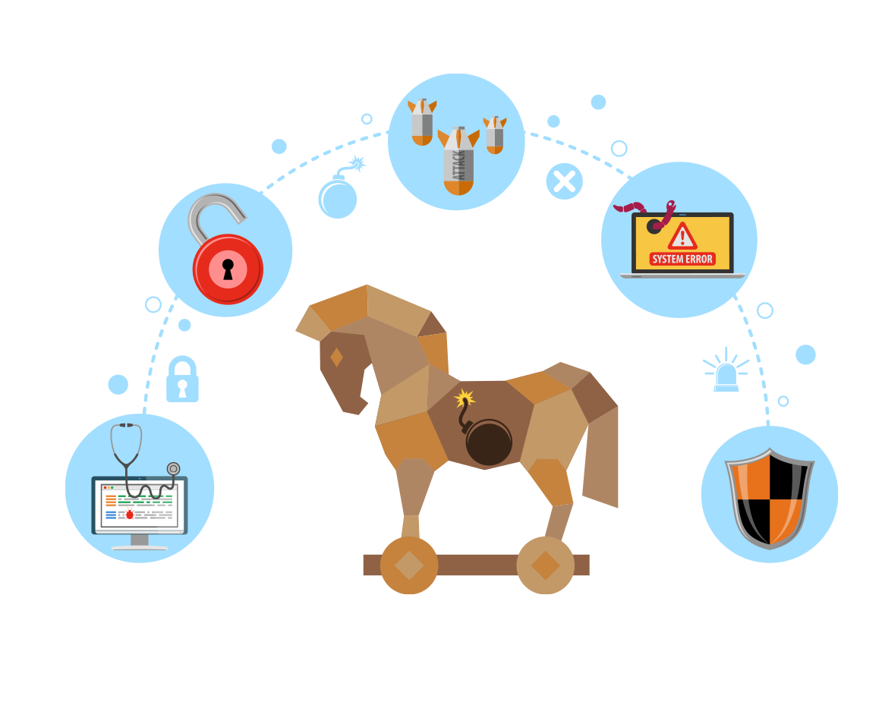
Trojans and RATs
A victim’s computer is referred to as a zombie when the attacker is able to send remote commands to the victim’s computer. This can be used for many purposes, such as downloading additional malicious programs.
Botnets are two or more zombie computers that are being remotely controlled by an attacker.
Notes:
Image source: Jono Yuen

Slide 85
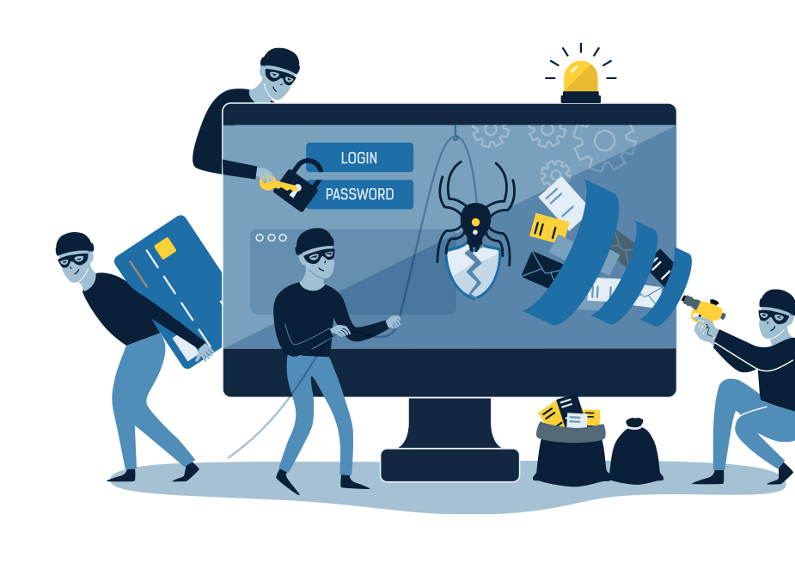
Spyware, Adware, and Keyloggers
Spyware is a program that gains a foothold into the victim’s system, and can be installed with or without the user’s knowledge. They monitor user activity and send the information to an external source.
Keyloggers actively attempt to steal confidential information by capturing the keystrokes of the victim. Keyloggers can be viewed as a type of spyware as they are hidden on the remote computer system and used to discreetly capture the victims information.
Adware is any type of software or browser plugin that displays or downloads advertisements via pop-ups. Some can act like spyware, for example, by tracking websites that a user visits.
Notes:
Image source: shutterstock_1034553598

Slide 86
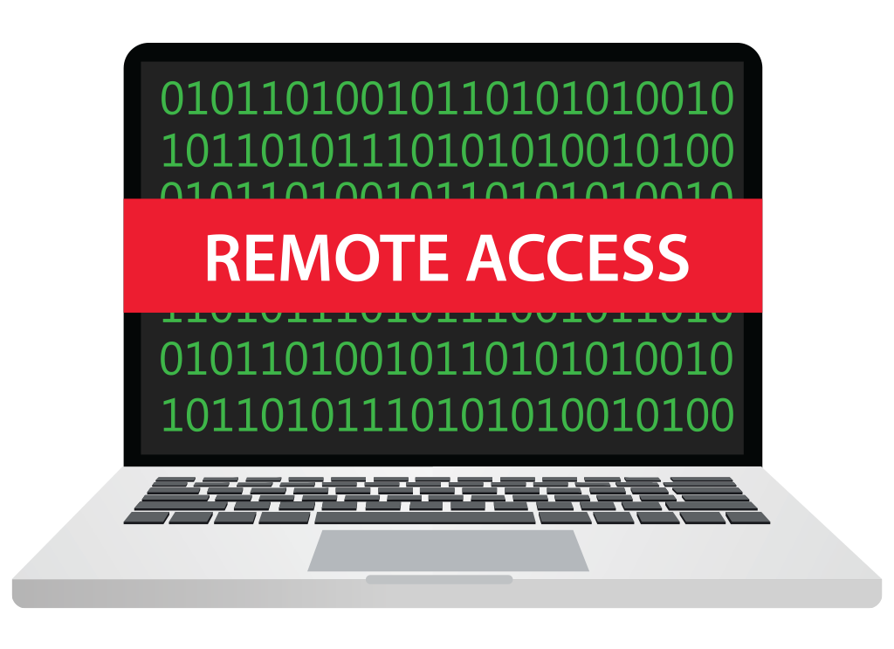
Backdoors
Backdoors are remote access methods that are installed without the user knowing.
These installations can occur if the user has unknowingly installed malware, such as a Trojan.
Backdoors can also be created in different ways:
Programers create backdoors in software application for testing and development, but then do not removed them when the application is deployed.
Some software or hardware misconfigurations can give unauthorized users access.
For example: a router can be left configured with the default administrative password.
Notes:
Image source: shutterstock_593559815

Slide 87
Rootkits
Some Trojans can often appear as a running service. These service names are typically configured to appear similar to real services in order to evade detection.
Rootkits are a type of backdoor that is more difficult to detect and remove. They can remain undetected by:
Changing core system files and programming interfaces. Therefore, the local shell processes can’t show their presence if run from an infected machine.
Using tools that clean system logs.
They are installing into the kernel of an operating system, which means that they can infect a machine through a corrupted device driver or kernel patch.
While less effective, some rootkits can operate in user mode, meaning that they can replace key utilities or less privileged drivers.

Slide 88
Vulnerabilities, Exploits, and Risks
Vulnerabilities are weaknesses that can be exploited by an attacker.
One broad category of vulnerabilities are zero-day vulnerabilities which occur when software or hardware that is released is not 100% secure.
Exploits are the way actors attack computer systems. They can be malware or scripts that disrupt the normal flow of the computer.
Risks can include known kept vulnerabilities.
The reason why these vulnerabilities are kept, are because it would either cost the business too much to protect against or the business would not be able to operate without this risk.
There are ways to reduce risks, but it is never possible to 100 percent fully remove all risks in an organization.
Organizations have a formula to calculate risks which is Risk = Likelihood × Impact.
Notes:
Image source: shutterstock_1401916403

Slide 89
Activity: Indicators of Compromise Questions
In this activity, you will work through Module 1.1 of the CertMaster Practice.
(Question sheets will be sent out by instructor.)
10 minutes

Slide 90
Question 1:
Which of the following is a type of a classic virus that infects executable files, and upon execution of an infected file, infects other files?
Macro viruses
Metamorphic viruses
File-infecting or classic viruses
Crypto-malware

Slide 91
Question 1:
Which of the following is a type of a classic virus that infects executable files, and upon execution of an infected file, infects other files?
Macro viruses
Metamorphic viruses
File-infecting or classic viruses
Crypto-malware
Extended Explanation
File-infecting or classic viruses infect executable files, and upon execution of an infected file, the viruses spread to other executable.
Macro viruses only affect documents of a specific type, such as DOC or DOCX files, and not executable files.
Metamorphic viruses are very complex viruses in that they can infect executable of different operating systems and they change code with each infection. This is not classic virus behavior.
Crypto-malware is not a virus, but a type of ransomware in which the attacker has encrypted a victim's files and demanded a ransom to have them unencrypted.

Slide 92
Question 2:
A network administrator suspects that several computers on the network have been compromised by malware because of the large numbers of TCP connections to a single IP address. Upon checking the IP address’ origin, the administrator finds that it belongs to a major political action committee. Which type of malware has infected this network?
Botnet
Trojan horse
3. Ransomware
4. Adware

Slide 93
Question 2:
A network administrator suspects that several computers on the network have been compromised by malware because of the large numbers of TCP connections to a single IP address. Upon checking the IP address’ origin, the administrator finds that it belongs to a major political action committee. Which type of malware has infected this network?
Botnet
Trojan horse
3. Ransomware
4. Adware
Extended Explanation
A botnet infects multiple computers on a network in order to attack a target to halt its operation through a Distributed Denial of Service (DDoS) attack.
A trojan horse is hidden malware that causes damage to a system or gives an attacker a platform for monitoring and/or controlling a system. Its purpose is to remain stealthy and not reveal itself via network connections to an outside source.
Ransomware has a single purpose: to extort money from its victims. It will not create connections from the infected computer to any third party target.
Adware is noisy, annoying, and disruptive but does not make multiple network connections to a target in order to bring it down from a DDoS attack.

Slide 94
Question 3:
A user found that their personal data had been exfiltrated from their computer by a malicious program that they clicked on several weeks ago. Which type of malware infected the user's system?
Zombie
Spyware
Virus
Trojan horse

Slide 95
Question 3:
A user found that their personal data had been exfiltrated from their computer by a malicious program that they clicked on several weeks ago. Which type of malware infected the user's system?
Zombie
Spyware
Virus
Trojan horse
Extended Explanation
The user was infected by spyware, whose purpose is to exfiltrate user data to an external location.
A zombie is not a malware infection, but a computer connected to the Internet that has been compromised by an attacker and can be used to perform malicious tasks under remote direction.
A virus typically disrupts user productivity by disabling services and programs or entire systems, but does not exfiltrate data.
Trojan horses cause direct damage to a system or network of systems by allowing the Trojan writer to monitor or control a system that is inside the infected network.

Slide 96
Question 4:
A malicious actor has contacted multiple individuals at a company over multiple months in order to convince unsuspecting users to execute a malicious file on their systems. By doing so, the actor could covertly gain control of those systems and establish a presence inside the network. Which type of malware was the actor attempting to have the users execute?
Virus
Adware
Spyware
Trojan horse

Slide 97
Question 4:
A malicious actor has contacted multiple individuals at a company over multiple months in order to convince unsuspecting users to execute a malicious file on their systems. By doing so, the actor could covertly gain control of those systems and establish a presence inside the network. Which type of malware was the actor attempting to have the users execute?
Virus
Adware
Spyware
Trojan horse
Extended Explanation
The malicious actor (caller) is using social engineering tactics to have the victims execute a Trojan horse so that he or she can gain control of at least one computer inside the target network. This could be by sending the victims a file and requesting they open it.
A virus wouldn’t give the actor control of any computer, but would allow him or her to disrupt productivity.
Adware wouldn’t give the actor control, but could possibly allow them to exfiltrate data.
Spyware wouldn’t give the actor control, but would allow them to exfiltrate data.

Slide 98
Question 5:
Which of the following is an example of evidence that a system has been infected with some type of malware?
Anti-virus update notifications
Email being routed to a spam folder
Unsolicited pop-up advertisements
Windows updates notifications

Slide 99
Question 5:
Which of the following is an example of evidence that a system has been infected with some type of malware?
Anti-virus update notifications
Email being routed to a spam folder
Unsolicited pop-up advertisements
Windows updates notifications
Extended Explanation
Malware can generate unsolicited pop-up advertisements. These advertisements direct users to clandestine websites that can steal information or infest their system with more malware.
Normal notifications for anti-virus updates are not unusual.
Email that is routed to the junk or spam folder means that the email’s spam filter is working correctly.
Normal notifications for Windows updates are expected and not unusual.

Slide 100
Question 6:
A rootkit is a particularly dangerous type of malware. What makes it so dangerous?
It takes control of a system at the lowest levels while attempting to hide from detection.
It attaches to files and spread from one computer to another.
It generates unsolicited advertisements that direct users to sites infected with malware.
It records all keystrokes made by a user, exposing that user’s passwords.

Slide 101
Question 6:
A rootkit is a particularly dangerous type of malware. What makes it so dangerous?
It takes control of a system at the lowest levels while attempting to hide from detection.
It attaches to files and spread from one computer to another.
It generates unsolicited advertisements that direct users to sites infected with malware.
It records all keystrokes made by a user, exposing that user’s passwords.
Extended Explanation
A rootkit is so dangerous because it is designed to hide from normal detection methods. Rootkits attempt to integrate at the "root" or lowest level of a computer system, providing access to an attacker. Once an attacker has administrative privileges, they can further mask their activities, making detection nearly impossible.
Viruses attach to files and spread from one computer to another.
Adware generates unsolicited advertisements that direct users to sites infected with malware.
Keyloggers record all keystrokes made by a user, exposing that user's passwords.

Slide 102
Question 7:
What is the major benefit to an attacker using a so-called backdoor attack?
The backdoor can be opened and closed at will.
The backdoor automatically guarantees privileged system access.
An attacker can set up fake entry points.
The backdoor helps the attacker break into a target’s infrastructure without being discovered.

Slide 103
Question 7:
What is the major benefit to an attacker using a so-called backdoor attack?
The backdoor can be opened and closed at will.
The backdoor automatically guarantees privileged system access.
An attacker can set up fake entry points.
The backdoor helps the attacker break into a target’s infrastructure without being discovered.
Extended Explanation
Backdoors, which can exist for legitimate remote access, can also allow attackers into a network without discovery.
The backdoor cannot be opened and closed at will. If the attacker closes the backdoor, he or she no longer has access.
Backdoors are legitimate passages into a system or network and there is no need to set up fake entry points, which would be discovered.
Backdoors typically only provide access to a single point of entry, such as a single server, and not all access nor privileged access is guaranteed.

Slide 104
We just covered a lot!
Don’t feel overwhelmed.
By the time you receive your Certmaster Practice Tool later in the course, you will be more prepared to answer questions and learn about other domains.

